Slide 1



West Michigan AWS Users Group
Deploying Infrastructure-as-Code Using CloudFormation and Python
+

Slide 2
Introductions

Slide 3
CloudFormation Benefits
AWS service for declarative infrastructure-as-code
Supports nearly every AWS resource and allows custom CFN resources for crafty engineers.
Cost-effective (practically free)
Fully supported by your AWS contract
AWS Secrets/SSM Parameter Store integration
No state file to manage

Slide 4
CloudFormation Detriments
Proprietary Syntax – no loop support until July 2023!
Not DRY
Clunky syntax
Can be difficult at scale without a programmatic approach
Modules and concepts are yet another thing to learn

Slide 5
Why Troposphere?
1to1 resource to class mapping
Pre-processes CloudFormation template generation
Autogenerated from CFN refspec
Python syntax enables intuitive programming logic
Intrinsic functions supported
CFN-Lint custom rules written in Python
The world is your oyster!

Slide 6
Why not CDK?
Many vendors still provide AWS CloudFormation templates to deploy their services
Slow. No parallel deployments without additional engineering
Debugging can be difficult due to non-descript errors
Abstraction of CDK to CFN can be confusing
Abstraction of resources making them “invisible in code” may not be desired or welcomed for auditing/tracking purposes. (I.E. Role creation)

Slide 7
Strategies
Per application
Mono repo

Slide 8
Per Application
The good:
Keeps all code specific to one app together
Simple for application developers to update
Keeps app permissions restricted to the teams that own it
Shorter CI times
The bad:
CFN Exports not easy to find in code, requires AWS CLI/Console discovery
Fragmented infrastructure code base
Not all teams document or communicate effectively if siloed

Slide 9
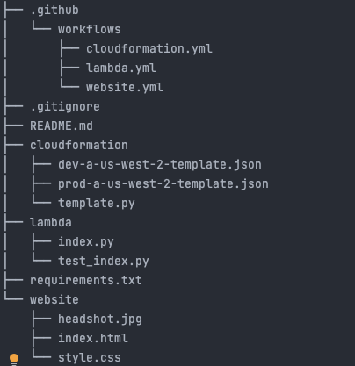
Per application project layout

Slide 10
Per App Repo Example
https://github.com/tnielsen2/cloud-resume-challenge

Slide 11
Mono Repo
The good:
All infrastructure code is bundled in the same place
CI and linting is DRY
Exports easy to handle
The bad:
App code not bundled alongside CI
Siloed teams may an undesired side effect
Longer app/CI execution time
Requires additional CI to deploy changes to an application outside of mono repo

Slide 12
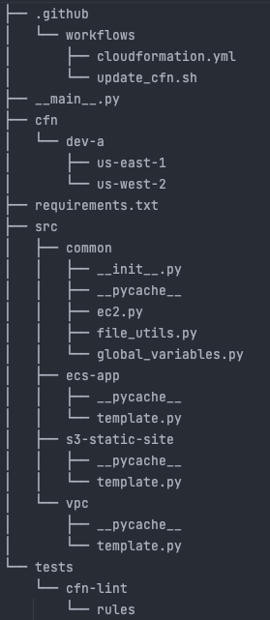
Mono repo

Slide 13
Mono Repo Example
https://github.com/tnielsen2/troposphere-infrastructure

Slide 14
Components
Templates
CI
Modules
Code Linting/Testing
Deployment Tools

Slide 15

Template Intentions
Imperative configuration
Designed to be the source of truth for all post-processed templates
Templates should reference modules (mono repo)
Built-in validators not present in CFN-Lint (Ex. RDS)
Has 1to1 parity to CFN attributes
Used to generate multiple CFN files

Slide 16
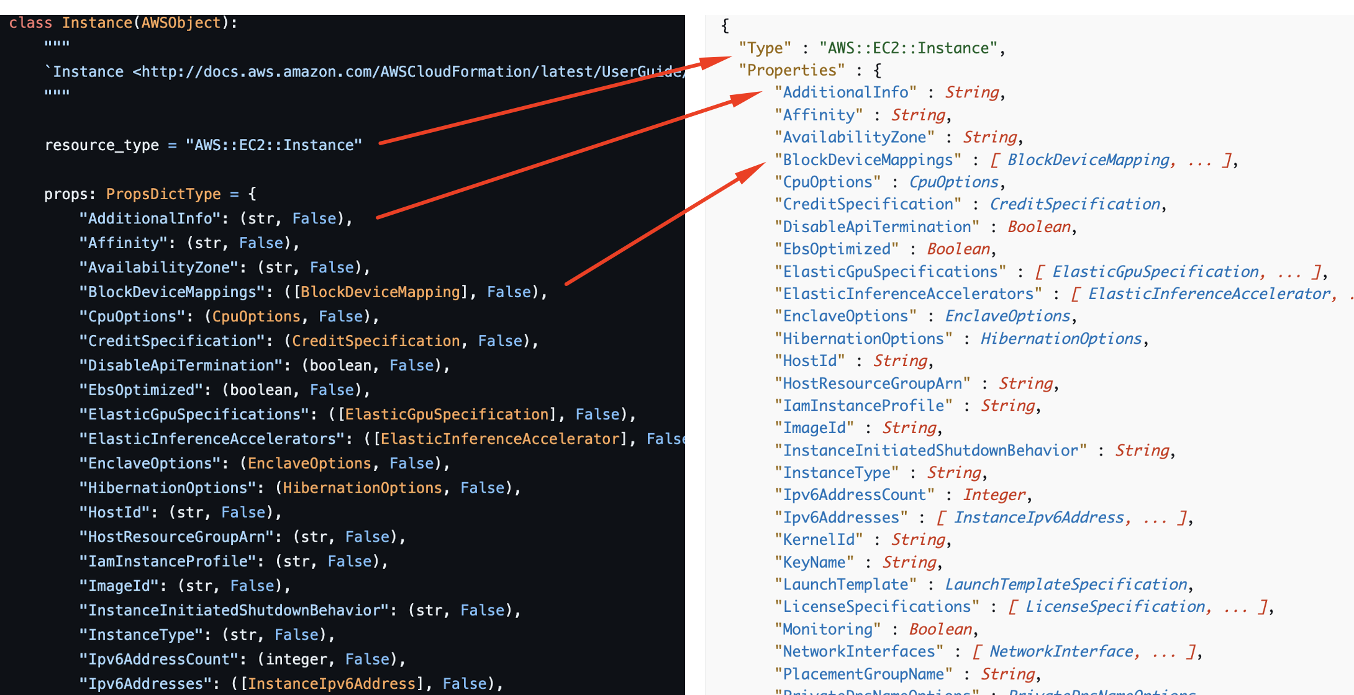
Troposphere Object Parity

Slide 17
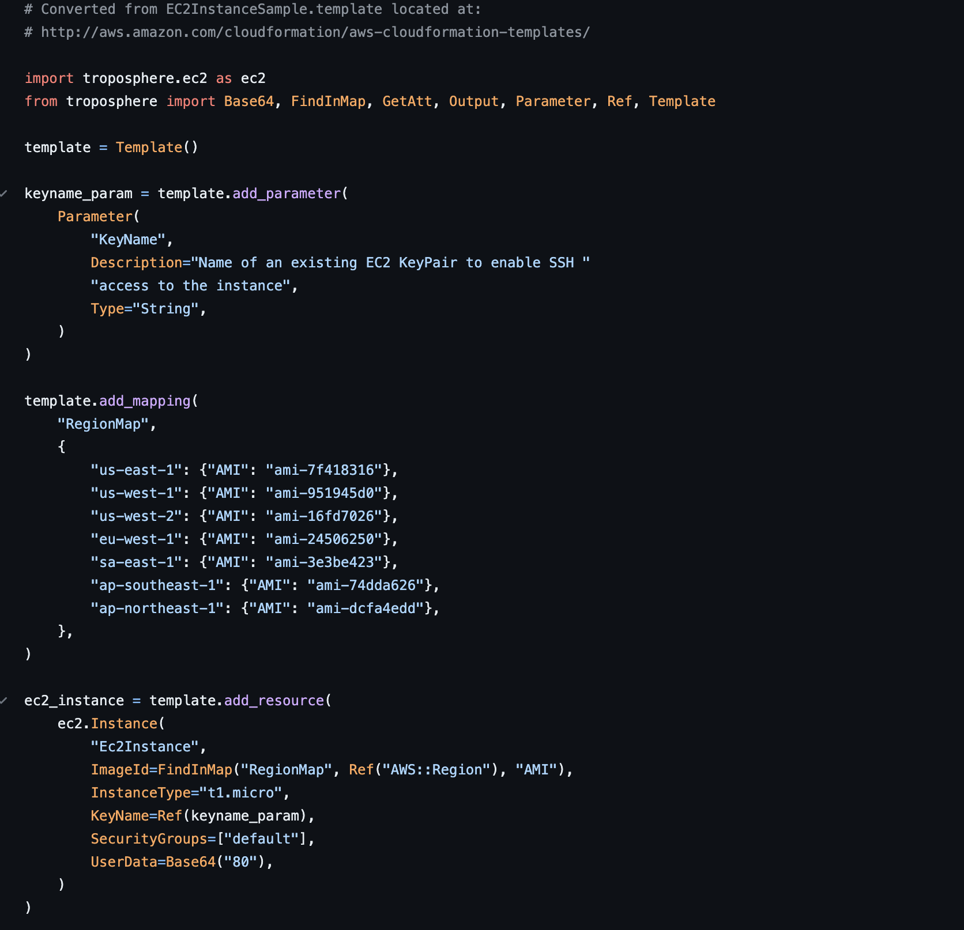
Troposphere Object Example

Slide 18
Module Intentions
Intended to keep code DRY
Modify resources across multiple repos with versioned modules
Extra overhead to publish and maintain for private registries
Not required but recomended
Use case examples:
Deploy AWS resources with the same security groups and naming convention
Repeat across multiple repos/stacks
Update centrally from module versions

Slide 19
Code Linting and Testing
Enforce styles and standards
PEP
Black/Blue/Other
Pylint
Testing
Prevent invalid CFN configuration (saving time)
Prevent dangerous deployments
Test deployment functionality

Slide 20
Deployment Tools
AWS-CLI
https://docs.aws.amazon.com/cli/latest/reference/cloudformation/deploy/index.html
Boto3
https://boto3.amazonaws.com/v1/documentation/api/latest/reference/services/cloudformation.html
Scepter
https://docs.sceptre-project.org/4.2.2/

Slide 21

CI/CD
Deploy/update
Deploy/update app Requires deployment/update of files, updating Docker image tags, etc.
Deploy/update
Deploy/update infrastructure
Validate/Test
Validate/Test application
Test
Test and lint your code

Slide 22
Mono Repo CI Using Github Actions
https://github.com/tnielsen2/troposphere-infrastructure/blob/7248a62386b312ebf3dc5085a5bd82956d333fa5/.github/workflows/cloudformation.yml

Slide 23
App Repo Using Github Actions
https://github.com/tnielsen2/cloud-resume-challenge/tree/master/.github/workflows

Slide 24

Update and Deployment Demonstration

Slide 25

Thanks
For questions, please contact Trent Nielsen
trentnielsen84@gmail.com

